Slide 1

Artificial Neural Network (ANN)
02116987 Kwon, jihun

Slide 2
What is ANN??
Artificial Neural Network
Deep learning model which imitate the human’s neural system
Each of neuron connected to the other neuron and transport the information through it.
=> Doing calculation and pass that information to the next neuron
Notes:
ANN의 정의
어떻게 사람의 뇌와 ANN이 닮아있는가?

Slide 3
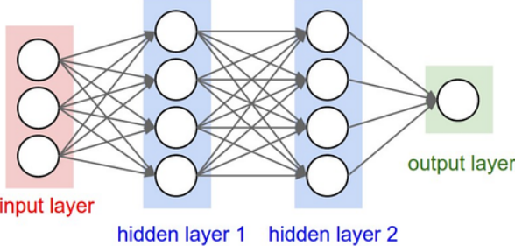
Structure of ANN
Perceptron
=> Unit of ANN
Can be more than 2
Notes:
ANN structure간단하게 설명하고,
그 단위는 perceptron이다

Slide 4
Structure of ANN
Node
Input layer :
normal data input part
Hidden layer :
Actual calculation happen
Output layer:
result
branch
Notes:
각각의 layer에 대해서 자세히 설명
Hidden layer1 = input layer of hidden layer2

Slide 5
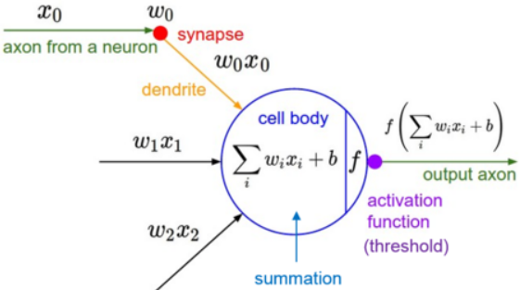
Perceptron
Way to calculate in each perceptron
w: Weight
b: Bias
It use those parameter to control the value
Notes:
Unit인 perceptron에서의 연산
각각의 가지
이해하기 쉬우려면 가지에서 가중치가 곱해지고, bias는 그 output layer에서 더해져서 최종값이 activation function을 거쳐서 나가게 된다.

Slide 6
Structure of ANN
All calculation is based on “matrix transformation”
Quiz:
If input comes (28,1)...
What is hidden layer’s dimension??
Notes:
연산의 흐름 설명 : 연산은 결국 matrix transformation로 해결이 된다 (식을 하나하나 하기에는 너무 많은 연산) -> 효율적으로 한다
제대로 이해했는지 check

Slide 7
Activation function
Since we cannot expect the non-linear case with only linear calculation, we need this “Activation function”.
Type of function
ReLU
Sigmoid
Tanhx
Softmax
… ETC
Need to choose proper function
depends on the problem

Slide 8
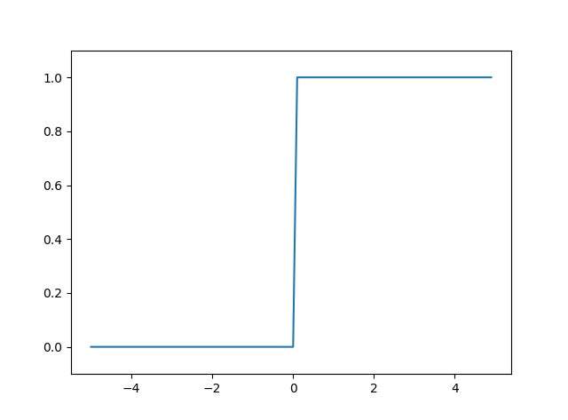
Step-function
0 or 1
Advantage
Simple
Disadvantage
Only classification (binary)
=> Nothing can say more than classification (how much? Isn’t too tight?)

Slide 9
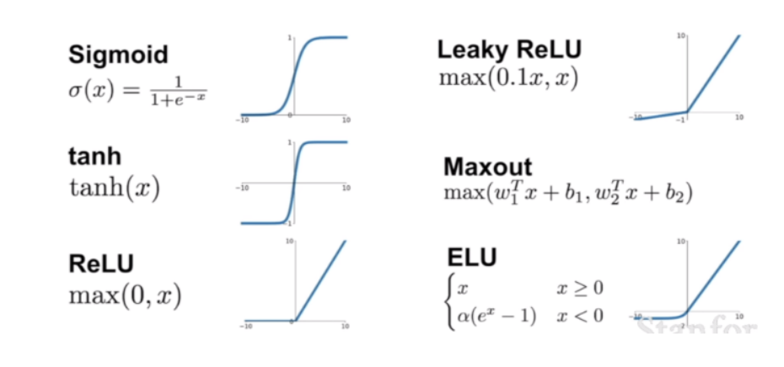
Sigmoid
Have value between 0-1
=> Output can express as probability
Differentiable at all point
Bigger if the value close to 0
Usually use in linear model (output layer) or Binary classification
-> Why??
Gradient vanishing (max gradient = 0.25)
Notes:
기울기 소실 : 최대 기울기가 0.25라서 계속 작아짐
Binary classification의 경우, 이진분류의 배반사건의 확률은 1-해당 사건의 확률

Slide 10
Tanhx
Since sigmoid has only positive value as result, we try to use the tanh(x) to get the negative value also

Slide 11
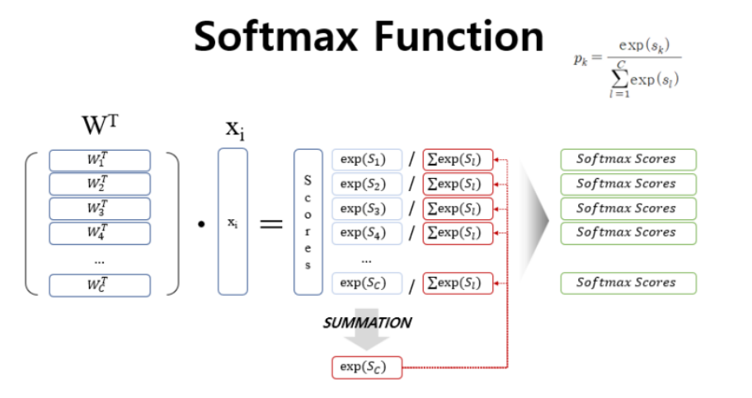
Softmax
In multi-classification problem, we use Softmax
Normalize all exponential of input to (0-1)
Sum(output) = 1 -> (probability)
Get the max value of output
+) Argmax -> max value of input
=> Using with one-hot encoding
Notes:
기울기 소실 : 지수함수의 변환을 쓰기에, gradient vanishing의 경우가 생긴다
시그모이드랑 비슷하게, 출력값은 그 녀석일 확률이라고 생각하면 된다.
J개의 클래스중에서 클래스 i를 알고 싶다!

Slide 12
ReLU
If value <0 -> 0
Else -> that value
Easy to get gradient value(0 or 1)
Easy to calculate all node(fast)
Since it deal with all negative as 0, which means death of node, we can easily lose the value

Slide 13
Leaky ReLU
To supplement the ReLU’s node death, Leaky ReLU deal the negative value as small (multiple the small value) but not 0
Quiz
Which use more in the real??
ReLU vs Leaky ReLU
Notes:
ReLU가 현실에서는 계산 활용성때문에 더 잘쓰인다고 한다.

Slide 14
Flow of ANN
After Data pre-processing…
Design the ANN dimension (N of hidden layer, N of node… etc)
Data flow
Propagation (Result came out with initial arbitory weight and bias)
Back propagation (Process to tuning weight, bias… etc’s parameter based on result)

Slide 15
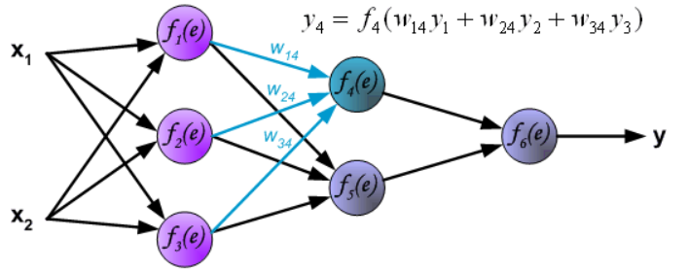
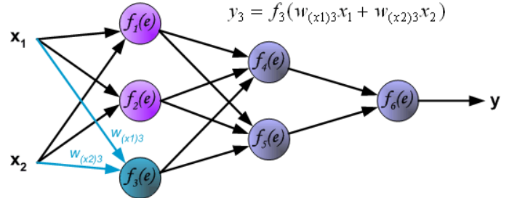
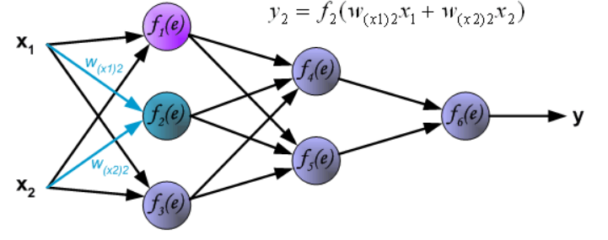
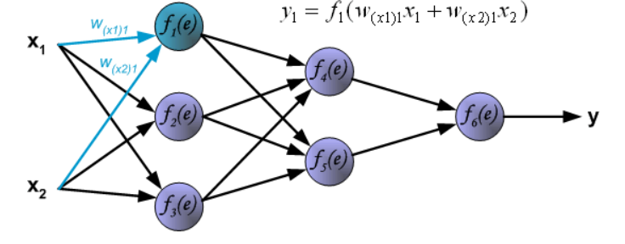
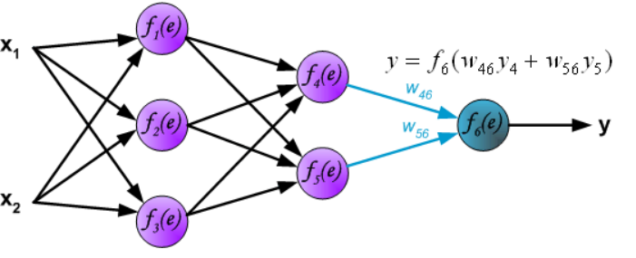
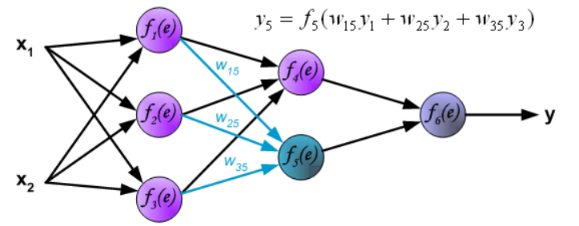
Propagation
Figure refer : https://galaxy.agh.edu.pl/~vlsi/AI/backp_t_en/backprop.html

Slide 16




Loss function
Calculating the error with ‘Loss function’
Regression
MSE, MAE, RMSE
Huber’s loss (MAE + MSE)…etc
Classification
Binary cross entrophy
Categorical cross entrophy
Hinge loss… etc
Notes:
MSE, MAE, RMSE -> 단순 수치연산
MSE
오차의 제곱 -> penalty가 강하다 but 이상치(outlier)에 매우 민감
RMSE
오차의 제곱에 루트를 씌워 그 이상치 민감성을 떨어뜨림
MAE
오차의 크기를 반영 -> 민감성이 떨어짐 하지만 절대값을 씌움으로써 오차가 크든 작든 기울기가 일정하여, 최적점에 가까워졌을 때 정교한 학습이 힘들다
Huber’s loss -> if 오차 > critical value -> MAE 오차 < critical value -> MSE
Binary cross entrophy
실제 정답 * ln(예측값) + (1-정답)ln(1-예측값)
Categorical cross entrophy
Binary 확장판
yij​: 원-핫 인코딩(One-Hot Encoding)**된 실제 정답. i번째 데이터가 j번째 클래스에 속하면 1, 아니면 0
y^ij : 실제 정답 i번째 데이터가 j번쨰 클래스에 속할 확률
i번째 데이터의 경우에 대해서 j번째 클래스가 될 확률을 전부 더함
Hinge loss
y*y(hat) -> 예측 점수의 부호(방향) * 실제값 >1 => 방향이 같고, 크기가 있다 -> 손실이 0
반대는 그 값이 손실이 됨 -> 방향과 얼마나 그 크기를 반영했는가?

Slide 17
Back Propagation
Do the thing what exactly did reversely
Calculate output data with trace back through loss function
Calculate value that how that node’s weight affect to loss with trace back through the chain rule
Correct those weight and bias with standard (optimization)
Figure refer : https://galaxy.agh.edu.pl/~vlsi/AI/backp_t_en/backprop.html

Slide 18


Back propagation
Let we have one hidden layer with 1 nodes and Loss function : L = $\frac{1}{2}(y−y)^2$
Assume the first input as x, hidden layer’s output as z
1. Calculating the output from Loss value
=> we know both value

Slide 19




Back propagation
Let we have one hidden layer with 1 nodes and Loss function : L = $\frac{1}{2}(y−y)^2$
1. Calculating hidden layer’s node value through differentiated Loss value
Since we know all value, we can calculate how weight affect to Loss
- Trace activation function back
- a: input data from previous node

Slide 20
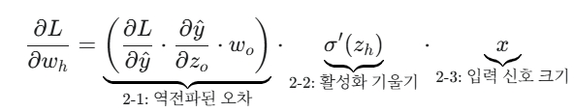

Back propagation
Let we have one hidden layer with 1 nodes and Loss function : L = $\frac{1}{2}(y−y)^2$
As same as before, calculate the affect the hidden layer’s weight to loss

Slide 21



Back propagation
Let we have one hidden layer with 1 nodes and Loss function : L = $\frac{1}{2}(y−y)^2$
Update the weight based on those result (Optimization)
Gradient decent
$η : learning rate(학$습률)
Quiz : Why we subtract this data from old weight??
Notes:
학습률 : 그 영향력을 얼마나 반영할것인가?

Slide 22
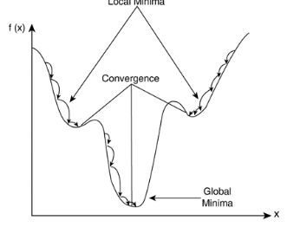
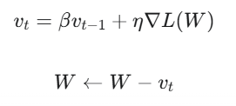
Optimization method
Momentum
if their has pond make that optimization stuck, learning cannot reach the best point
Add Momentum to increase the speed and give the chance to get out from the pond

Slide 23
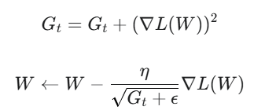
Optimization method
Adagrad
Apply different value of learning rate
was changed a lot -> change as low magnitude
Was changed little -> change as big magnitude
Notes:
Gt​: 각 가중치의 과거 기울기 제곱 값들을 누적한 값
ϵ: 분모가 0이 되는 것을 방지하는 작은 값 (예: 10−8)

Slide 24
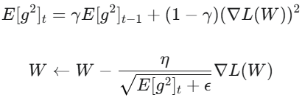
Optimization method
RMSprop
Since G(t) can grow endlessly, makes learning rate converge to 0, Learning can stop in adagrad
Giving more weight to recent gradient using exponential moving average
Gradient
Vector represent the steepest way in multi-variable function (using the partial differentiation)
EMA (exponential moving Average)
Notes:
Gamma : 지수이동평균의 감쇠율
E(g**2)t : 기울기 제곱 값의 지수이동평균

Slide 25

Optimization method
RMSprop
Gradient
Vector represent the steepest way in multi-variable function (using the partial differentiation)
EMA (exponential moving Average)
Calculation of time series data which put the more weight in recent data
Notes:
Gamma : 지수이동평균의 감쇠율
E(g**2)t : 기울기 제곱 값의 지수이동평균
EMA에서
B : decay rate(감쇠율)

Slide 26
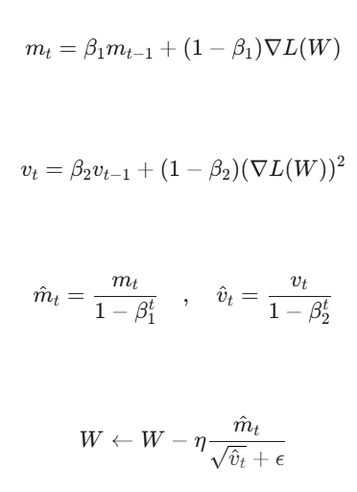
Optimization method
Adam
RMSprop + Adagrad
Since it has disadvantage from EMA way (get bias(low rate) of learning rate in first part) try to figure out with combining two method
EMA (exponential moving Average)
Calculation of time series data which put the more weight in recent data
Notes:
1. Mt : 최근 그래디언트들의 평균적인 방향과 크기 (momentum)
2. Vt : 최근 그래디언트들의 크기 변동성(variance). 이 값이 크다는 것은 그래디언트가 자주 급변했다는 뜻입니다.
분모에 있기에, Mt의 값이 방향이 같은 값이 계속 나오면 값 자체가 켜져 그것이 가속화 된다고 하면, Vt는 그래디언트가 클때는 크게 갈수있게, 작을때는 작게 가서 조정할수 있게 한다.
B1,b2 : 각각의 모멘텀에 대한 감쇠율
3. 편향 보정 : 초반의 값이 bias를 가지지 않게 보정한다

Slide 27
Epoch, batch, iteration
Batch : how many data would you learn for update your weight and bias??
Iteration : how many trial that machine need to finish the data once.
Epoch : Number of trial that you finish the data
Ex) Let we assume that we have 5000 data and we try to deal with 500 per trial. If the machine finished the whole data one time, what’s Batch, Iteration, Epoch of this system??
Notes:
Batch : 몇 개를 한번에 학습할 것이냐
Iteration : 데이터 전체를 한번 읽는데 몇번을 학습해야하는가?
Epoch : 몇번 그 데이터 전체를 읽어냈느냐?
답 : batch : 500, epoch : 1 iteration : 10

Slide 28
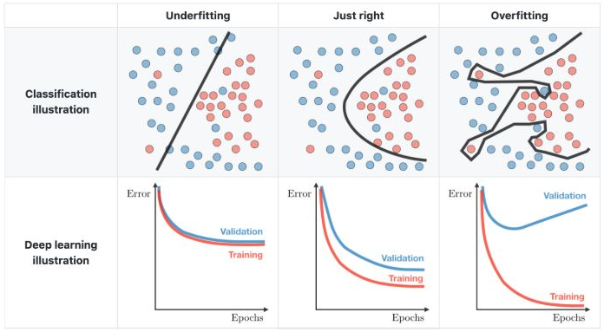
Overfitting/underfitting
Which one can represent the ‘GOOD’ model??
Those thing can happen with various reasons.
Ex) data’s biased distribution, overcomplexity model, over iterated learning process… etc
In this session, we will focus on the model view
Notes:
우리가 기출만 가지고 시험치면 지식은 없지만 점수만 높듯, 여기서도 그런 일이 발생한다
과대적합과 과소적합이 그 종류
여러 이유로 발생함

Slide 29
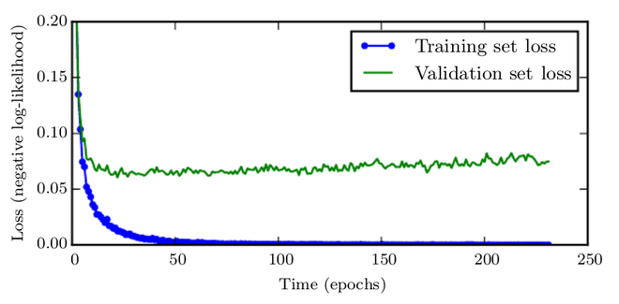
Overfitting/underfitting
Too complex model structure makes model to make 1:1 match
=> Make model little bit simple
Over learning makes machine to focus the train data only
=> Stop learn in certain time
Notes:
Validation loss와 training loss가 어느정도 줄어들고, validatio이 더 이상 줄어들지 않고 trainin만 줄어드는 경우
=> 멈춰야 될 시점

Slide 30


Overfitting/underfitting
We can put little “penalty” for machine prevent to induce overfitting
Regularization
Giving incidental penalty
Giving the things to update
Notes:
L1 라쏘
L2 릿지
Lamda가 정규화 정도를 정한다 (hyper parameter)
Hyper parameter : 모델에 우리가 주는 값
Model parameter : 모델이 배워 나가는 값

Slide 31
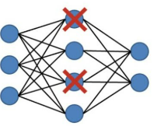
Overfitting/underfitting
We can put little “penalty” for machine prevent to induce overfitting
Drop out
Disable random node in certain timing
Weight not update
Giving the things to update

Slide 32
Overfitting/underfitting
Underfitting
- Gradient vanishing
- Small iteration
- Too simple model

Slide 33
H.W
Design your own simple model and calculate all data by your hand

Slide 34
Next time…
Let assume we have 5000 row of data with 20 features
If we design one hidden layer (10 nodes) for that, machine need to caluate…
Totally about 4.3million times that machine need to do
If we have a lot of data (100000 or more) and more feature(40 or more) and more dataset(3 or more) and more complex model(5 hidden layer or more)…
Which can do better??

